Slide 1

Quantum Metric
Exploratory Research on Automotive Vehicle Selector
May 18, 2023

Slide 2
Canadian Tire ODP – Automotive Selector Overview
Search Criteria: Date Range: [March 1, 2023 – May 25, 2023]
Objective: Explore Quantum metric on touchpoints around the vehicle selector.
Dataset: Includes QM search segments used for research, Events, Top Pages metrics, Vehicle Selector metrics, and observation data on 30 QM Sessions.
Areas to explore:
Is searching the main way to find products in the auto part journey?
Engagement metrics on the selector
Product page views (with vehicle/tire size selected) on search, product pages and category pages
Drop off rate within vehicle selector, last field used, etc.
Time on Automotive pages with vehicle selected vs without
Time it takes a user to fills out the vehicle selector
Where and when is the vehicle selector being used (PDP, PLP, etc.)?

Slide 3
Canadian Tire ODP – Automotive Selector
Top Findings Summary:
In the end of March, there was a surge in vehicle selector usage.
Very few users shop without the selector.
Winter is the most popular time a user will view a page with an automotive selector.
The most popular way to find an automotive product is through the search query.
The most popular ways a user will reach a vehicle selector is through a PLP, search query, or a PDP.
Vehicle selector takes an average of 19.7 seconds to complete.
Users tend to drop off before or after they engage with the selector, but not during. This leads us to understand completing the selector flow is not a primary issue.

Slide 4
2023 User Engagement on Selector
[Mar. 1, 2023 – May25, 2023]
In the end of March, there was a surge in vehicle selector usage.
The vehicle selector is the most used option.
Very few users shop without the vehicle selector.
Event | Sessions | Conversion Rate | Abandoned Cart Value | Number of Abandoned Carts
Vehicle Added | 1,283,858 | 1.00% | $ 12,366,126 | 19,974
Shop By Tire Size | 382,418 | 1.17% | $ 8,663,092 | 10,393
Shop w No Vehicle | 32,083 | 1.74% | $ 585,333 | 1,013

Slide 5
2022 User Engagement on Selector
[Mar. 1, 2022 – May25, 2022]
Event tracking started in April 26, 2022. To get an accurate comparison, we will narrow down the time periods to April and May.
Event | Sessions | Conversion Rate | Abandoned Cart Value | Number of Abandoned Carts
Vehicle Added | 252,048 | 1.2% | $ 6,352,122 | 12,125
Shop By Tire Size | 76,880 | 1.16% | $3,492,460 | 4,801
Shop w No Vehicle | 23,729 | 1.4% | $ 742,557 | 1,442

Slide 6
Year Over Year (YoY) Engagement Metrics on Selector
[Apr. 26, 2023 – May25, 2023]
In 2023, the Conversion Rate for the Shop By Tire Size and Shop w No Vehicle categories showed improvement. However, the Conversion Rate for the Vehicle Added category witnessed a decline during the same period.
A decrease in the number of abandoned shopping carts is being observed overall.
Event | Sessions | Conversion Rate | Abandoned Cart Value | Number of Abandoned Carts
Vehicle Added | 506,154 | 1.05% | $ 3,983,828 | 7,004
Shop By Tire Size | 111,573 | 1.39% | $2,319,160 | 2,763
Shop w No Vehicle | 7,095 | 2.28% | $ 121,800 | 252
[Apr. 26, 2022 – May25, 2022]
Event | Sessions | Conversion Rate | Abandoned Cart Value | Number of Abandoned Carts
Vehicle Added | 241,342 | 1.15% | $ 6,042,605 | 11,703
Shop By Tire Size | 72,134 | 1.13% | $3,492,460 | 4,801
Shop w No Vehicle | 19,888 | 1.38% | $ 673,943 | 1,353

Slide 7
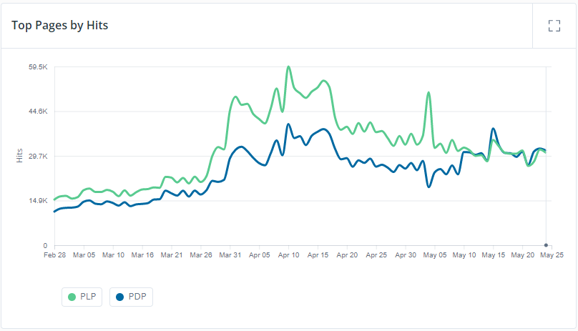
Page Views with Vehicle Selector
[Mar. 1, 2023 – May25, 2023]
The trend of vehicle selector engagement is consistent with that of page views across PDP and PLP, with PLP exhibiting higher levels of viewership.
A notable spike in PLP on May 04. This could be attributed to technical issues.
Page | Hits (Page Views) | Sessions | Users
PDP | 2,134,554 | 768,435 | 724,767
PLP | 2,781,500 | 1,073,637 | 1,011,684

Slide 8
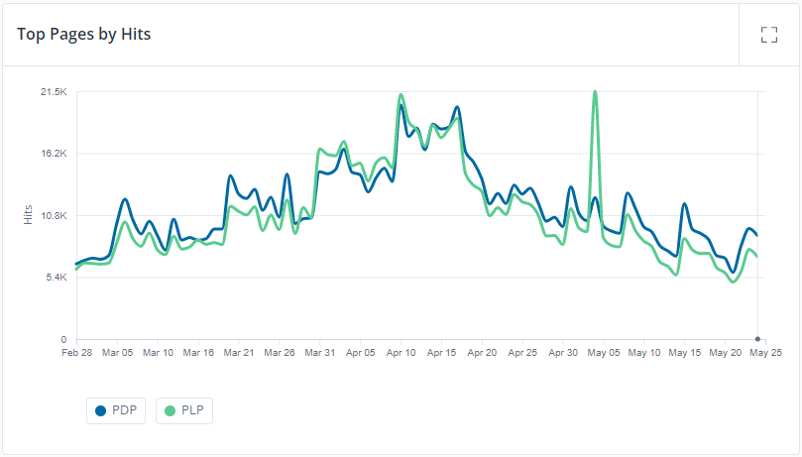
Page Views with Shop by Tire Size
[Mar. 1, 2023 – May25, 2023]
Page views show a similar trend with the engagement of the Tire selector.
Page | Hits (Page Views) | Sessions | Users
PDP | 989,798 | 300,393 | 265,377
PLP | 927,252 | 316,498 | 281,542

Slide 9
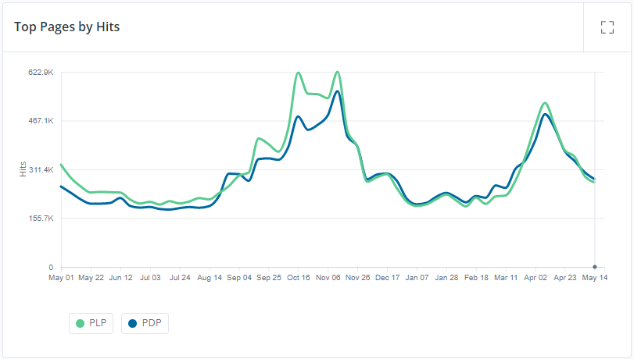
Seasonal Product Page Views With a Vehicle/Tire Selector
[May. 1, 2022 – May 25, 2023](1 Year range)
The page's activity experienced three notable spikes in October, November, and April, plausibly attributed to the transition of seasonal tire changes from winter to summer and vice versa.
Similar trends also occurred for users who didn’t use the vehicle/tire selector.
Page Group | Hits (Page Views) | Sessions | Users
PDP | 16,049,920 | 5,922,763 | 5,205,227
PLP | 17,051,224 | 5,887,268 | 5,171,664
Category Page | 16,689,616 | 5,869,757 | 5,157,381

Slide 10
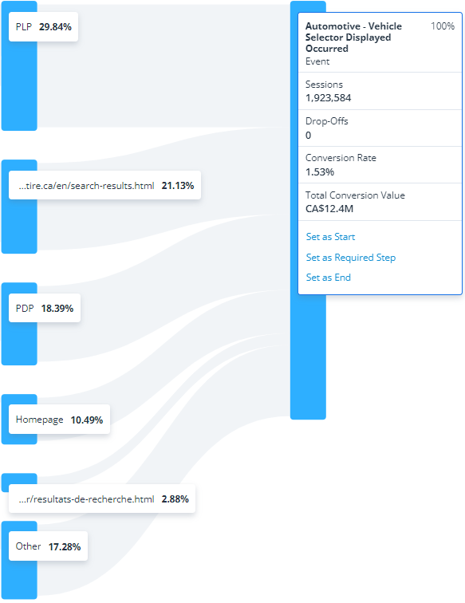
User Journey to Vehicle/Tire Size Selector
[Mar. 1, 2023 – May 15, 2023]
The most popular ways a user will reach a vehicle selector is through a PLP, search query, or a PDP.
English Searches
French Searches
Other includes anything not mentioned above: direct searches from Google, Bing, etc.

Slide 11
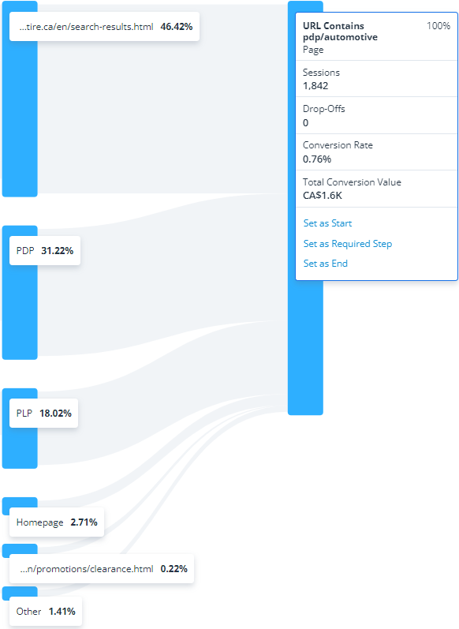
User Journey to find Automotive Products
[Mar. 1, 2023 – May 15, 2023]
English Searches
The most popular way to find an automotive product is through search results.
Other includes anything not mentioned above: direct searches from Google, Bing, etc.

Slide 12
Observations on 30 Sessions:
Where Vehicle Selector was Present, and Drop Offs Occurred
[Mar. 1, 2023 – May 15, 2023]
The vehicle selector takes an average of 19.7 seconds to complete, as observed in this sample.
Users tend to drop off before or after the selector, but never during. This leads us to understand completing the selector flow is not a primary issue.
Observation Results: [Data]
# Drop Offs Before Selector | # Drop Offs During Selector | # Drop Offs After Selector | Avg. Time to Fill Vehicle Selector(sec)
13 | 0 | 17 | 19.7s

Slide 13
Appendix

